Slide 1

12 o’clock
midday
12 o’clock
midnight
Time for school
morning

Slide 2
12 o’clock
midday
12 o’clock
midnight
afternoon
evening
There are 24 hours in one day.

Slide 3








If there are 24 hours in one day. I wonder how many hours there are in one week.
Let’s find out!
H T O
There are 168 hours in one week.
2
4
$×$
7
1
6
8
1
2
Have a think

Slide 4
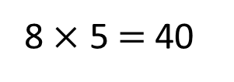
There’s 8 weeks to go until the next school holiday!
How many school days is that?
There are 5 school days in each week.
8 $×$ 5 $=$ 40
There are 40 school days in 8 weeks.
Have a think

