Slide 1
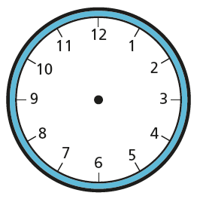

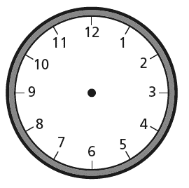
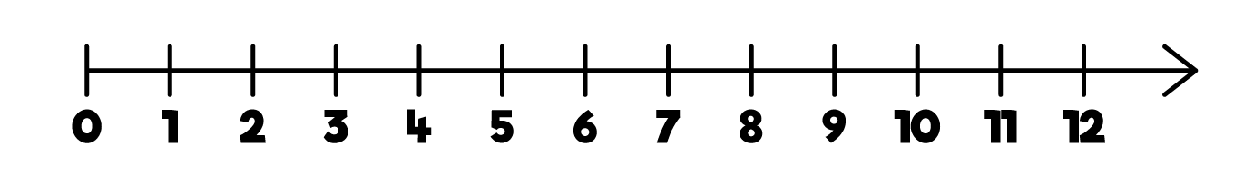
1 minute past 5
5 o’clock
5 minutes past 5
1 hour
= 60 minutes
5 mins
5 minutes
60 minutes ÷ 12 =

Slide 2
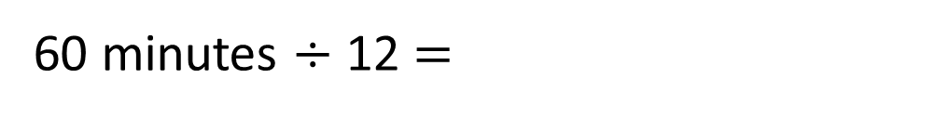
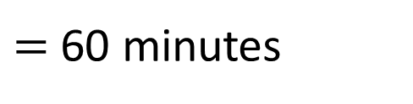
10 minutes past 5
15 minutes past 5
5 minutes past 5
20 minutes past 5
1 hour
$=$ 60 minutes
5 mins
5 mins
5 mins
5 mins
5 minutes
60 minutes ÷ 12 $=$

Slide 3

O’clock
5 to
5 past
10 to
10 past
Quarter
to
to
past
Quarter
past
20 to
20 past
25 to
Half
past
25 past

Slide 4


Draw hands on the clock to show 20 to 8
Can you find the 2 mistakes Tiny has made?
Can you correct them?
Tiny has drawn 20 past
The hour hand has
already reached 8
Have a think

