Slide 1
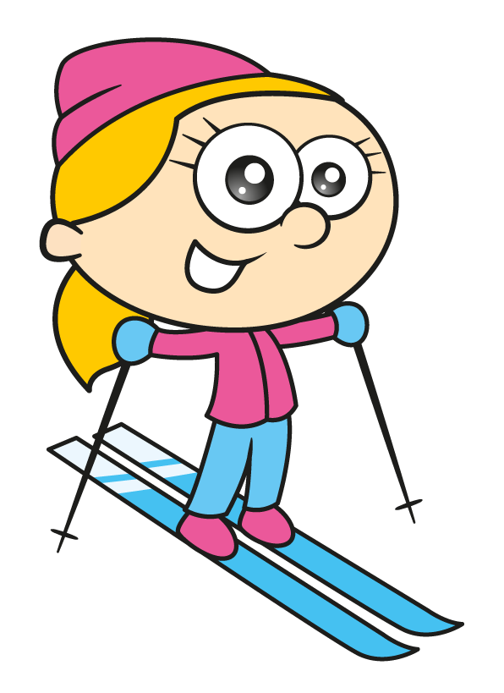
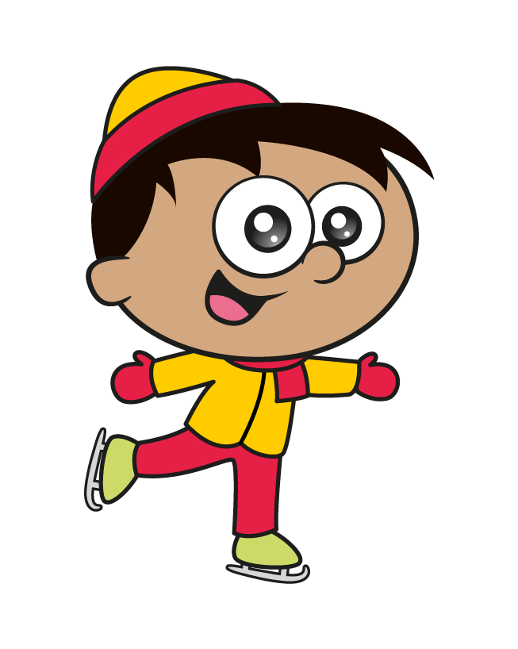
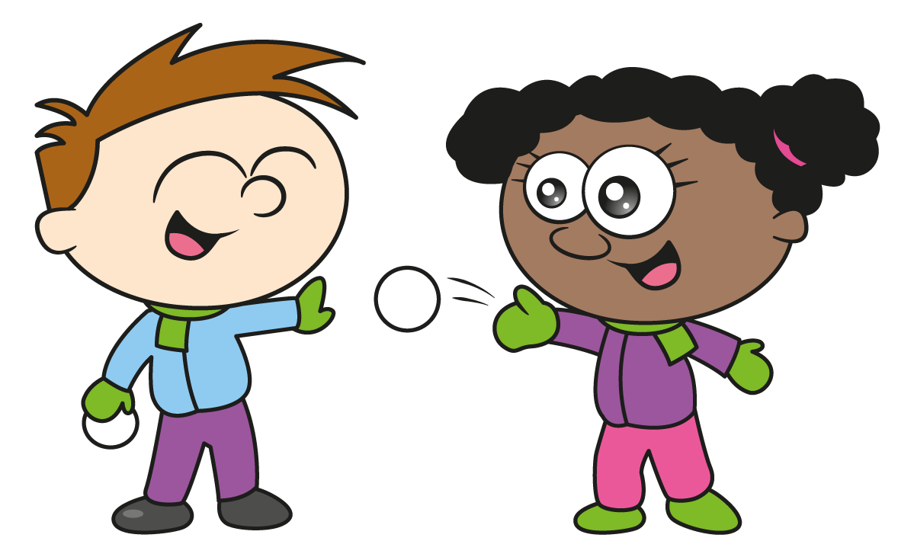
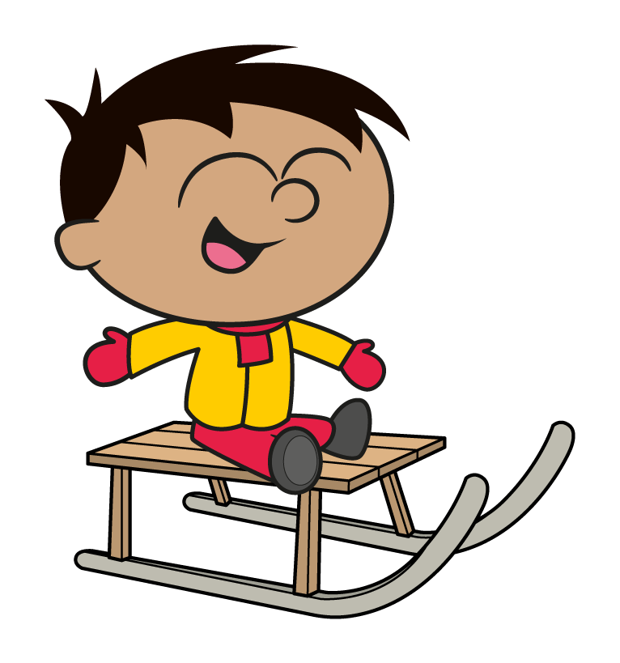

Slide 2
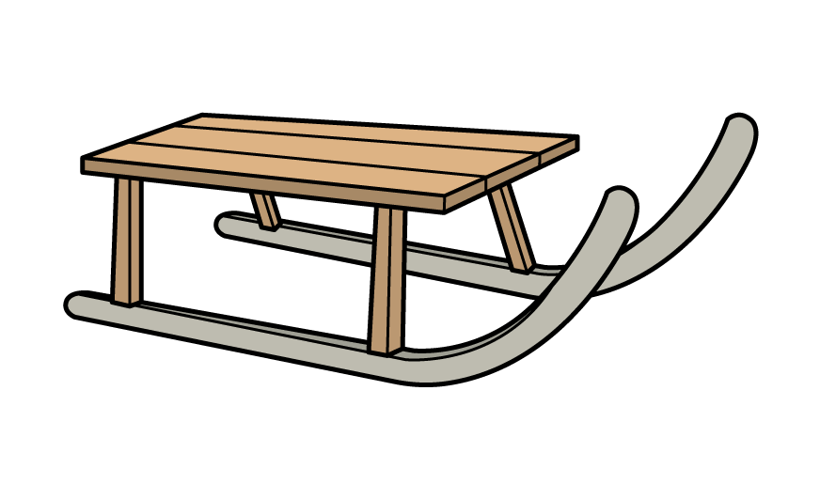
 | 9.45am – 10.45am | 10.55am – 11.55am | 11.55am – 1pm | 1pm – 2pm | 2.10pm – 3.10pm
Green tickets | Sledging | Winter wonderland walk and treasure hunt | Lunch | Marshmallow roasting and campfire songs | Winter arts and crafts
Yellow tickets | Winter wonderland walk and treasure hunt | Sledging | Lunch | Winter arts and crafts | Marshmallow roasting and campfire songs
Blue tickets | Marshmallow roasting and campfire songs | Winter arts and crafts | Lunch | Sledging | Winter wonderland walk and treasure hunt
How long is lunch?
Give your answer in minutes.
1 hour = 60 minutes
65 minutes
1 hour
60 minutes
5 mins
Have a think
11:55 am
12:55pm
1:00 pm

Slide 3
A ticket for the day costs £25, and includes lunch.
Winter activity day!
Sledging
Winter walk
Lunch costs £7
Arts
Marshmallows
Sledging and marshmallow roasting cost the same.
The winter walk is half the price of sledging.
Arts and crafts is twice as expensive as marshmallow roasting.
What is the cost of sledging?
Have a think

Slide 4
25 $−$ 7 =
18
Arts and crafts is twice as expensive as marshmallow roasting.
Sledging and marshmallow roasting cost the same.
The winter walk is half the price of sledging.
What is the cost of sledging?
£4
Sledging
£2
£2
Marshmallows
£2
£2
£18 ÷ 9 =
£2
£18
Walk
£2
Arts
£2
£2
£2
£2

Slide 5
 | 9.45am – 10.45am | 10.55am – 11.55am | 11.55am – 1pm | 1pm – 2pm | 2.10pm – 3.10pm
Green tickets | Sledging | Winter wonderland walk and treasure hunt | Lunch | Marshmallow roasting and campfire songs | Winter arts and crafts
Yellow tickets | Winter wonderland walk and treasure hunt | Sledging | Lunch | Winter arts and crafts | Marshmallow roasting and campfire songs
Blue tickets | Marshmallow roasting and campfire songs | Winter arts and crafts | Lunch | Sledging | Winter wonderland walk and treasure hunt
The activity centre uses 80 marshmallows for each hour they are being roasted.
How many marshmallows does the centre need to purchase per day?
3
× 80 =
240 marshmallows
Have a think

Slide 6
The centre uses 240 marshmallows per day.
The centre is open for 5 days a week.
How many marshmallows does the centre need to purchase for 2 weeks?
2,400 marshmallows
240
$×$ 5
$×$ 10 =
$×$ 2
2,400
Have a think
10

Slide 7
 | 9.45am – 10.45am | 10.55am – 11.55am | 11.55am – 1pm | 1pm – 2pm | 2.10pm – 3.10pm
Green tickets | Sledging | Winter wonderland walk and treasure hunt | Lunch | Marshmallow roasting and campfire songs | Winter arts and crafts
Yellow tickets | Winter wonderland walk and treasure hunt | Sledging | Lunch | Winter arts and crafts | Marshmallow roasting and campfire songs
Blue tickets | Marshmallow roasting and campfire songs | Winter arts and crafts | Lunch | Sledging | Winter wonderland walk and treasure hunt
How long is it between green ticket holders finishing sledging and blue ticket holders starting sledging?
2 hours 15 mins
2 hours
15 mins
Have a think
10:45 am
12:45pm
1:00 pm

Slide 8
 | 9.45am – 10.45am | 10.55am – 11.55am | 11.55am – 1pm | 1pm – 2pm | 2.10pm – 3.10pm
Green tickets | Sledging | Winter wonderland walk and treasure hunt | Lunch | Marshmallow roasting and campfire songs | Winter arts and crafts
Yellow tickets | Winter wonderland walk and treasure hunt | Sledging | Lunch | Winter arts and crafts | Marshmallow roasting and campfire songs
Blue tickets | Marshmallow roasting and campfire songs | Winter arts and crafts | Lunch | Sledging | Winter wonderland walk and treasure hunt
During the winter wonderland walk people walk at 80 metres per minute.
Have a think
How far is the winter wonderland walk in kilometres?
Walk takes 1 hour
Walk takes 60 minutes
80 × 60 =
4,800 metres
1,000 m $=$ 1 km
8 × 6 = 48
4.8 kilometres

Slide 9
 | 9.45am – 10.45am | 10.55am – 11.55am | 11.55am – 1pm | 1pm – 2pm | 2.10pm – 3.10pm
Green tickets | Sledging | Winter wonderland walk and treasure hunt | Lunch | Marshmallow roasting and campfire songs | Winter arts and crafts
Yellow tickets | Winter wonderland walk and treasure hunt | Sledging | Lunch | Winter arts and crafts | Marshmallow roasting and campfire songs
Blue tickets | Marshmallow roasting and campfire songs | Winter arts and crafts | Lunch | Sledging | Winter wonderland walk and treasure hunt
Why do you think there are 10 minute gaps between each activity?
Have a think
To allow people enough time to move between the different activities.

