Slide 1
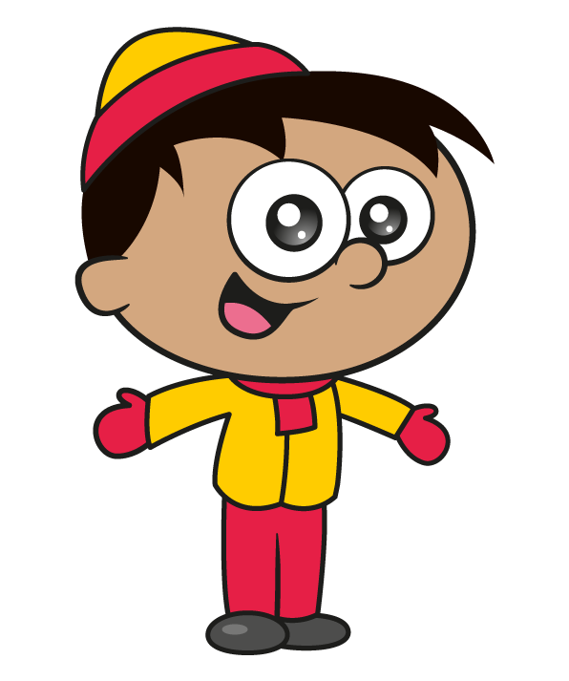
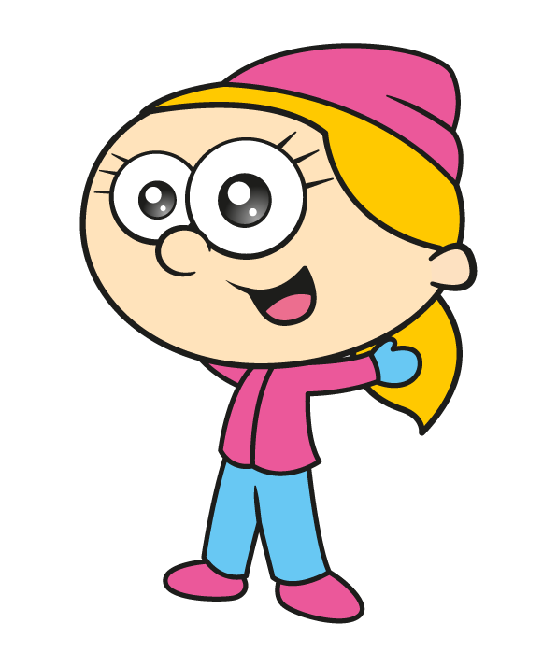
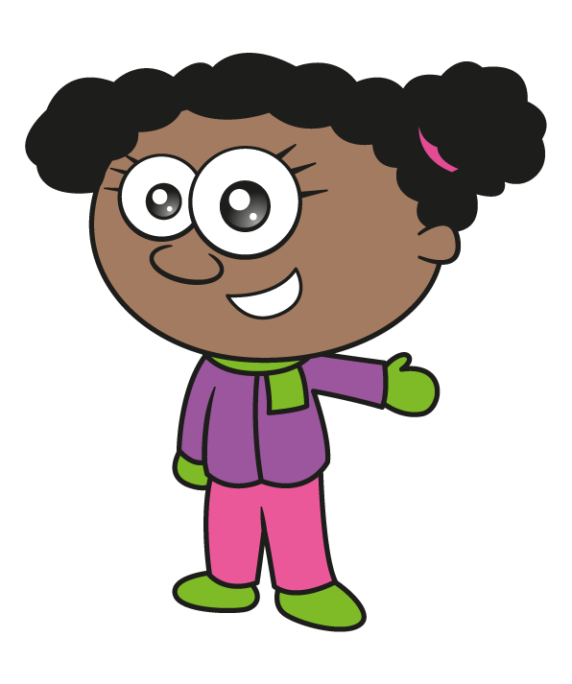

Slide 2
Winter jumpers are sold with this red design.
12 cm
6 cm
20 cm
The design has a horizontal line of symmetry shown by the dotted line.
9 cm
What is the area of the red design?
Have a think

Slide 3
12 cm
What is the area of the red design?
A
6 cm
9 × 6 =
54
54 × 2 =
108
20 cm
C
20 × 3 =
60
3 cm
9 cm
108 + 60 =
168 cm
2
B
6 cm

Slide 4
12 cm
What is the area of the red design?
6 cm
20 × 12 =
240
20 cm
8 cm
8 × 9 =
72
9 cm
240 $−$ 72 =
168 cm
2
6 cm

Slide 5
In a class of 30, a third of pupils wear this winter jumper on a non-uniform day.
Have a think
What is the total area of the red pattern amongst the entire class?
168 cm
2
Th | H | T | O
30
10
168 × 10 =
2
1,680 cm
$×$ 10
$×$ 10
$×$ 10
Jumper
30 ÷ 3 =
10 wear the jumper

Slide 6
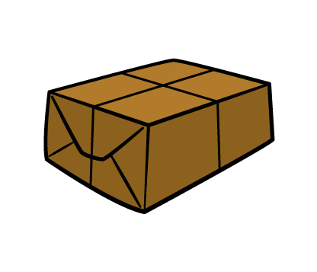
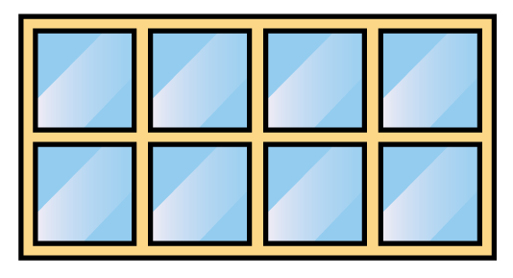
Winter scarves are sold in boxes.
There are two scarves in each box.
In a shop window, a giant square is made out of these boxes.
The window can fit a square which is 4 boxes high and 4 boxes long.
How many scarves are displayed in the window?
Have a think

Slide 7
4
4 × 4 =
2
4 $=$
16 boxes
4
16 × 2 =
32 scarves

Slide 8
A clothing company makes red and blue winter hats.
5 times as many red hats as blue hats are made.
In a week the company makes 420 hats.
How many more red hats than blue hats does the company make in 5 weeks?
Have a think

Slide 9
70
70
70
70
70
420
70 × 4 =
280
70
420 ÷ 6 =
70
280 more in 1 week

Slide 10
280 more in 1 week
How many more in 5 weeks?
280 × 5 =
280 × 10 =
2,800
2,800 ÷ 2 =
1,400
1,400 more red hats

