Slide 1


Slide 3

1) 2,100 $÷$ 7 $=$
2) 843 $÷$ 3 $=$
3) 955 $÷$ 5 $=$
4) 816 $÷$ 24 $=$

Slide 4
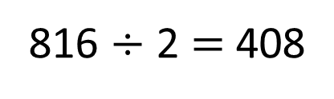
1) 2,100 $÷$ 7 $=$
2) 843 $÷$ 3 $=$
3) 955 $÷$ 5 $=$
4) 816 $÷$ 24 $=$
300
3 | 8 | 4 | 3
2
8
1
281
2
5 | 9 | 5 | 5
1
9
1
191
4
12 | 4 | 0 | 8
34
3
4
4
2
12
816 $÷$ 2 $=$ 408

Slide 6
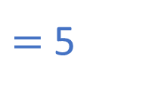

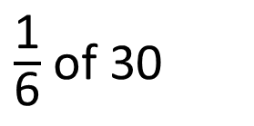
$\frac{\text{1}}{\text{6}}$ of 30
$=$ 5
30
5
?
30 $÷$ 6 $=$
5

Slide 7
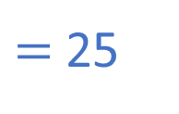

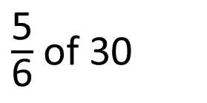
$\frac{\text{5}}{\text{6}}$ of 30
$=$ 25
30
5
5
5
5
5
?
30 $÷$ 6 $=$
5
5 $×$ 5 $=$
25

Slide 8

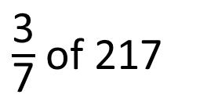
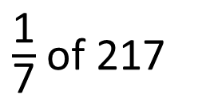
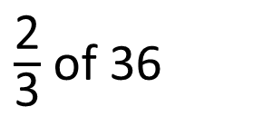
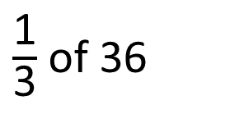
$\frac{\text{1}}{\text{3}}$ of 36
$\frac{\text{1}}{\text{7}}$ of 217
$\frac{\text{2}}{\text{3}}$ of 36
$\frac{\text{3}}{\text{7}}$ of 217
Have a think

Slide 9
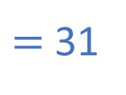
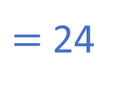
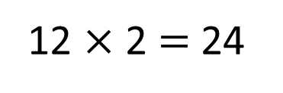
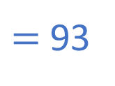
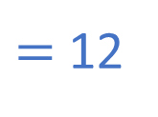
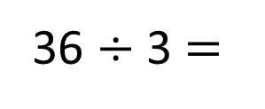
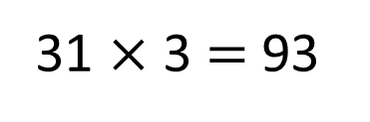
$\frac{\text{1}}{\text{3}}$ of 36
$\frac{\text{1}}{\text{7}}$ of 217
$=$ 12
$=$ 31
$\frac{\text{2}}{\text{3}}$ of 36
$\frac{\text{3}}{\text{7}}$ of 217
$=$ 24
$=$ 93
36
217
12
12
31
31
31
?
7 | 2 | 1 | 7
?
3
1
36 $÷$ 3 $=$
12
12 $×$ 2 $=$ 24
31 $×$ 3 $=$ 93

Slide 10
Have a go at questions
1 - 3 on the worksheet

Slide 11

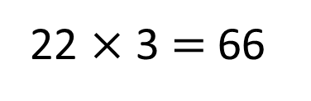
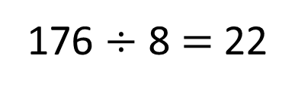
Dora has been saving up her pocket money and she has £176
She uses $\frac{\text{3}}{\text{8}}$ of her pocket money to buy some trainers.
How much money did she spend?
£66
£176
?
?
?
22
22
22
8 | 1 | 7 | 6
2
2
1
Spends on trainers
176 $÷$ 8 $=$ 22
22 $×$ 3 $=$ 66

Slide 12
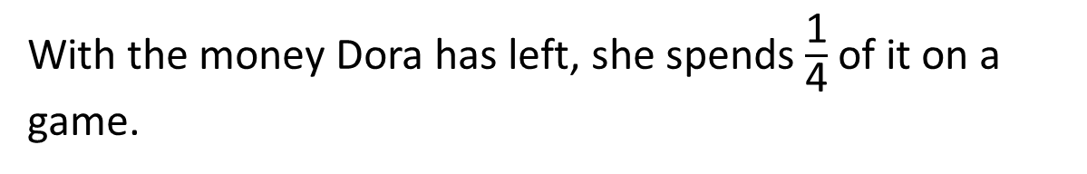
With the money Dora has left, she spends $\frac{\text{1}}{\text{4}}$ of it on a game.
How much pocket money does Dora have left after she’s bought the game?
£176
22
22
22
Spends on trainers
Have a think

Slide 13
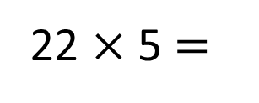
With the money Dora has left, she spends $\frac{\text{1}}{\text{4}}$ of it on a game.
How much pocket money does Dora have left after she’s bought the game?
£176
22
22
22
Spends on trainers
£66
Pocket money left
£110
22 $×$ 5 $=$
£110 left

Slide 14
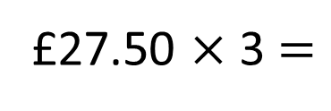
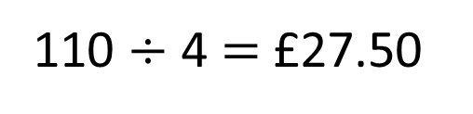
With the money Dora has left, she spends $\frac{\text{1}}{\text{4}}$ of it on a game.
How much pocket money does Dora have left after she’s bought the game?
£176
£82.50
22
22
22
£66
£110
110 $÷$ 4 $=$ £27.50
27.50
£27.50 $×$ 3 $=$
£82.50
A game
?

Slide 15
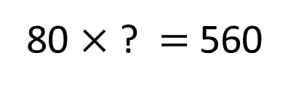
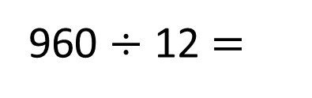
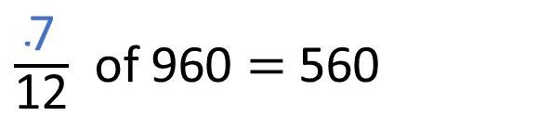
$\frac{\text{7}}{\text{12}}$ of 960 $=$ 560
960
80
80
80
80
80
80
80
80
80
80
80
80
560
960 $÷$ 12 $=$
80
80 $×$ ? $=$ 560

Slide 16
Have a go at the rest of the questions on the worksheet

