Slide 3
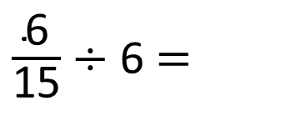
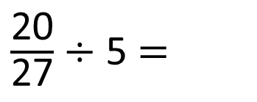
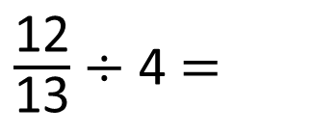
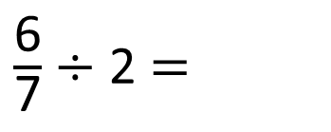
$\frac{\text{6}}{\text{7}}$ $÷$ 2 $=$
1)
2)
3)
4)
$\frac{\text{12}}{\text{13}}$ $÷$ 4 $=$
$\frac{\text{20}}{\text{27}}$ $÷$ 5 $=$
$\frac{\text{6}}{\text{15}}$ $÷$ 6 $=$

Slide 4




$\frac{\text{3}}{\text{7}}$
$\frac{\text{6}}{\text{7}}$ $÷$ 2 $=$
1)
2)
3)
4)
$\frac{\text{3}}{\text{13}}$
$\frac{\text{12}}{\text{13}}$ $÷$ 4 $=$
$\frac{\text{4}}{\text{27}}$
$\frac{\text{20}}{\text{27}}$ $÷$ 5 $=$
$\frac{\text{1}}{\text{15}}$
$\frac{\text{6}}{\text{15}}$ $÷$ 6 $=$

Slide 6
Have a think
$\frac{\text{1}}{\text{4}}÷$ 2

Slide 7
$\frac{\text{1}}{\text{4}}÷$ 2
$=$ $\frac{\text{1}}{\text{8}}$

Slide 8
$\frac{\text{1}}{\text{4}}÷$ 3 $=$ $\frac{\text{1}}{\text{12}}$
$\frac{\text{1}}{\text{4}}÷$ 4 $=$ $\frac{\text{1}}{\text{16}}$

Slide 9
Have a think
$\frac{\text{4}}{\text{5}}÷$ 3 $=$ $\frac{\text{4}}{\text{15}}$
$\frac{\text{4}}{\text{15}}$ is 3 times smaller than $\frac{\text{4}}{\text{5}}$

Slide 10
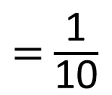
Have a think
$\frac{\text{4}}{\text{5}}÷$ 3 $=$ $\frac{\text{4}}{\text{15}}$
$\frac{\text{2}}{\text{5}}÷$ 3 $=$ $\frac{\text{2}}{\text{15}}$
$\frac{\text{2}}{\text{5}}÷$ 4 $=$ $\frac{\text{2}}{\text{20}}$
$=$ $\frac{\text{1}}{\text{1}\text{0}}$
$\frac{\text{2}}{\text{5}}÷$ 5 $=$ $\frac{\text{2}}{\text{25}}$

Slide 11
Have a go at questions 1 - 4 on the worksheet

Slide 12
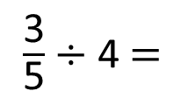

Dora has $\frac{\text{3}}{\text{5}}$ of a cake leftover.
Have a think
The leftover cake is shared equally between 4 people. What fraction of the whole cake does each person get?
$\frac{\text{3}}{\text{5}}$ $÷$ 4 $=$
$\frac{\text{3}}{\text{20}}$

Slide 13
Have a think
True or false?
$\frac{\text{2}}{\text{5}}$ $\text{÷}$ 3 $=$ $\frac{\text{2}}{\text{3}}$ $÷$ 5
Convince me

Slide 14
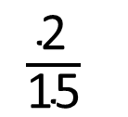
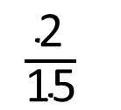
True or false?
$\frac{\text{2}}{\text{5}}$ $\text{÷}$ 3 $=$ $\frac{\text{2}}{\text{3}}$ $÷$ 5
$\frac{\text{2}}{\text{15}}$
$\frac{\text{2}}{\text{15}}$

Slide 15
Have a go at the rest of the questions on the worksheet

