Slide 1
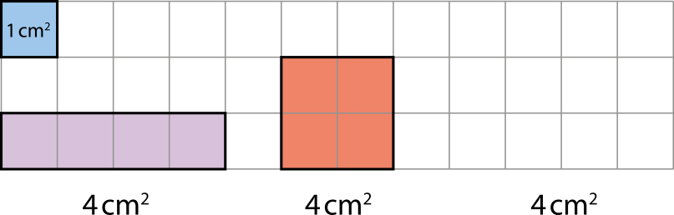
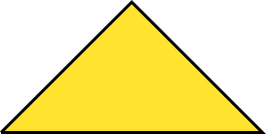




5G-2 Compare and calculate areas
The purple, red and yellow shapes above are drawn on centimetre squared paper. The blue square shows each square has an area of 1cm². How does this help to know that the area of each shape is 4cm²?
It is possible to count four squares inside the red and purple shapes.
It is possible to count two whole squares and visualize another two made from the four triangles inside the yellow shape.

Slide 2

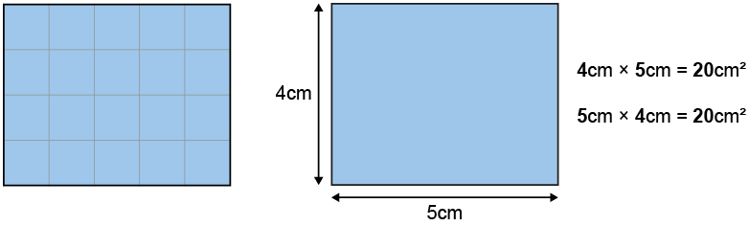
5G-2 Compare and calculate areas
Draw the shape shown on squared paper. Count the number of squares found within the shape using your finger tip that covers roughly the area of one squared centimetre (1cm²).
Is it possible to calculate the area in a more efficient way? Can the number of columns and rows of squares help?
The area of the rectangle is equal to 4 rows of 5 square centimetres,
or 5 columns of 4 square centimetres.
4 cm x 5 cm = 5 cm x 4 cm = 20 cm²

