Slide 1
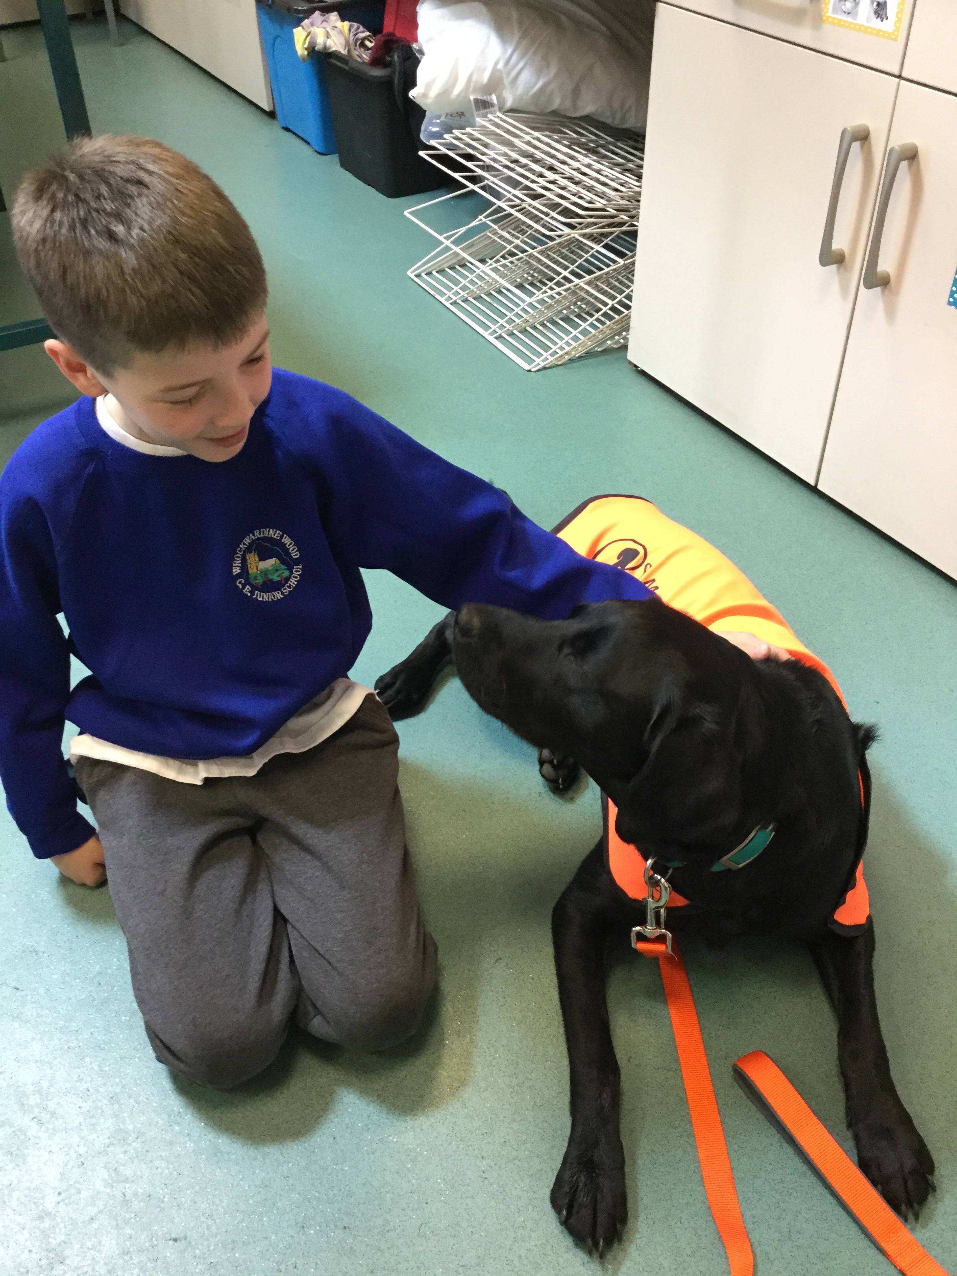
WELCOME
NALA
OUR NEW

Slide 2
Hello I am now training to be a dog mentor. I am here to help you every day in lots of different ways. Most importantly I'm here to be your friend. There are lots of ways that you can help me to be happy and safe in school...

Slide 3
working with the dog mentor
There should be no more than two people around me at a time
Always ask before stroking me
If given permission to stroke the me, you must lower yourself to the ground
Approach me using your Dog Mentor breathing
Stroke me from the chest or shoulder down to the tail
Never reach over the top of my head
You should not ruffle my fur

Slide 4
playground
When approaching me, try not to shout or be over-excited as I may get scared
No running towards me
Never stroke me when standing behind me
If you are playing with a ball try to keep the ball from travelling in my direction
I don't like it when people crowd around me - always ask permission to approach

Slide 5
CLASSROOM
* Sit in your seat
Keep your feet still and flat on the floor
Keep your hands on the table
Use your dog mentor breathing
Only stroke me if told to do so
Do not put food waste in the bin on the floor it must go in the bin outside
Be quiet and don’t call my name

Slide 6
moving around the school
Always walk around the school sensibly
Don't reach out to touch me when I'm passing
Use indoor voices
Try to keep my name inside your head rather than shout it out
In the Dog mentor Zone be very quiet as I may be having my break and a nice sleep.

Slide 7
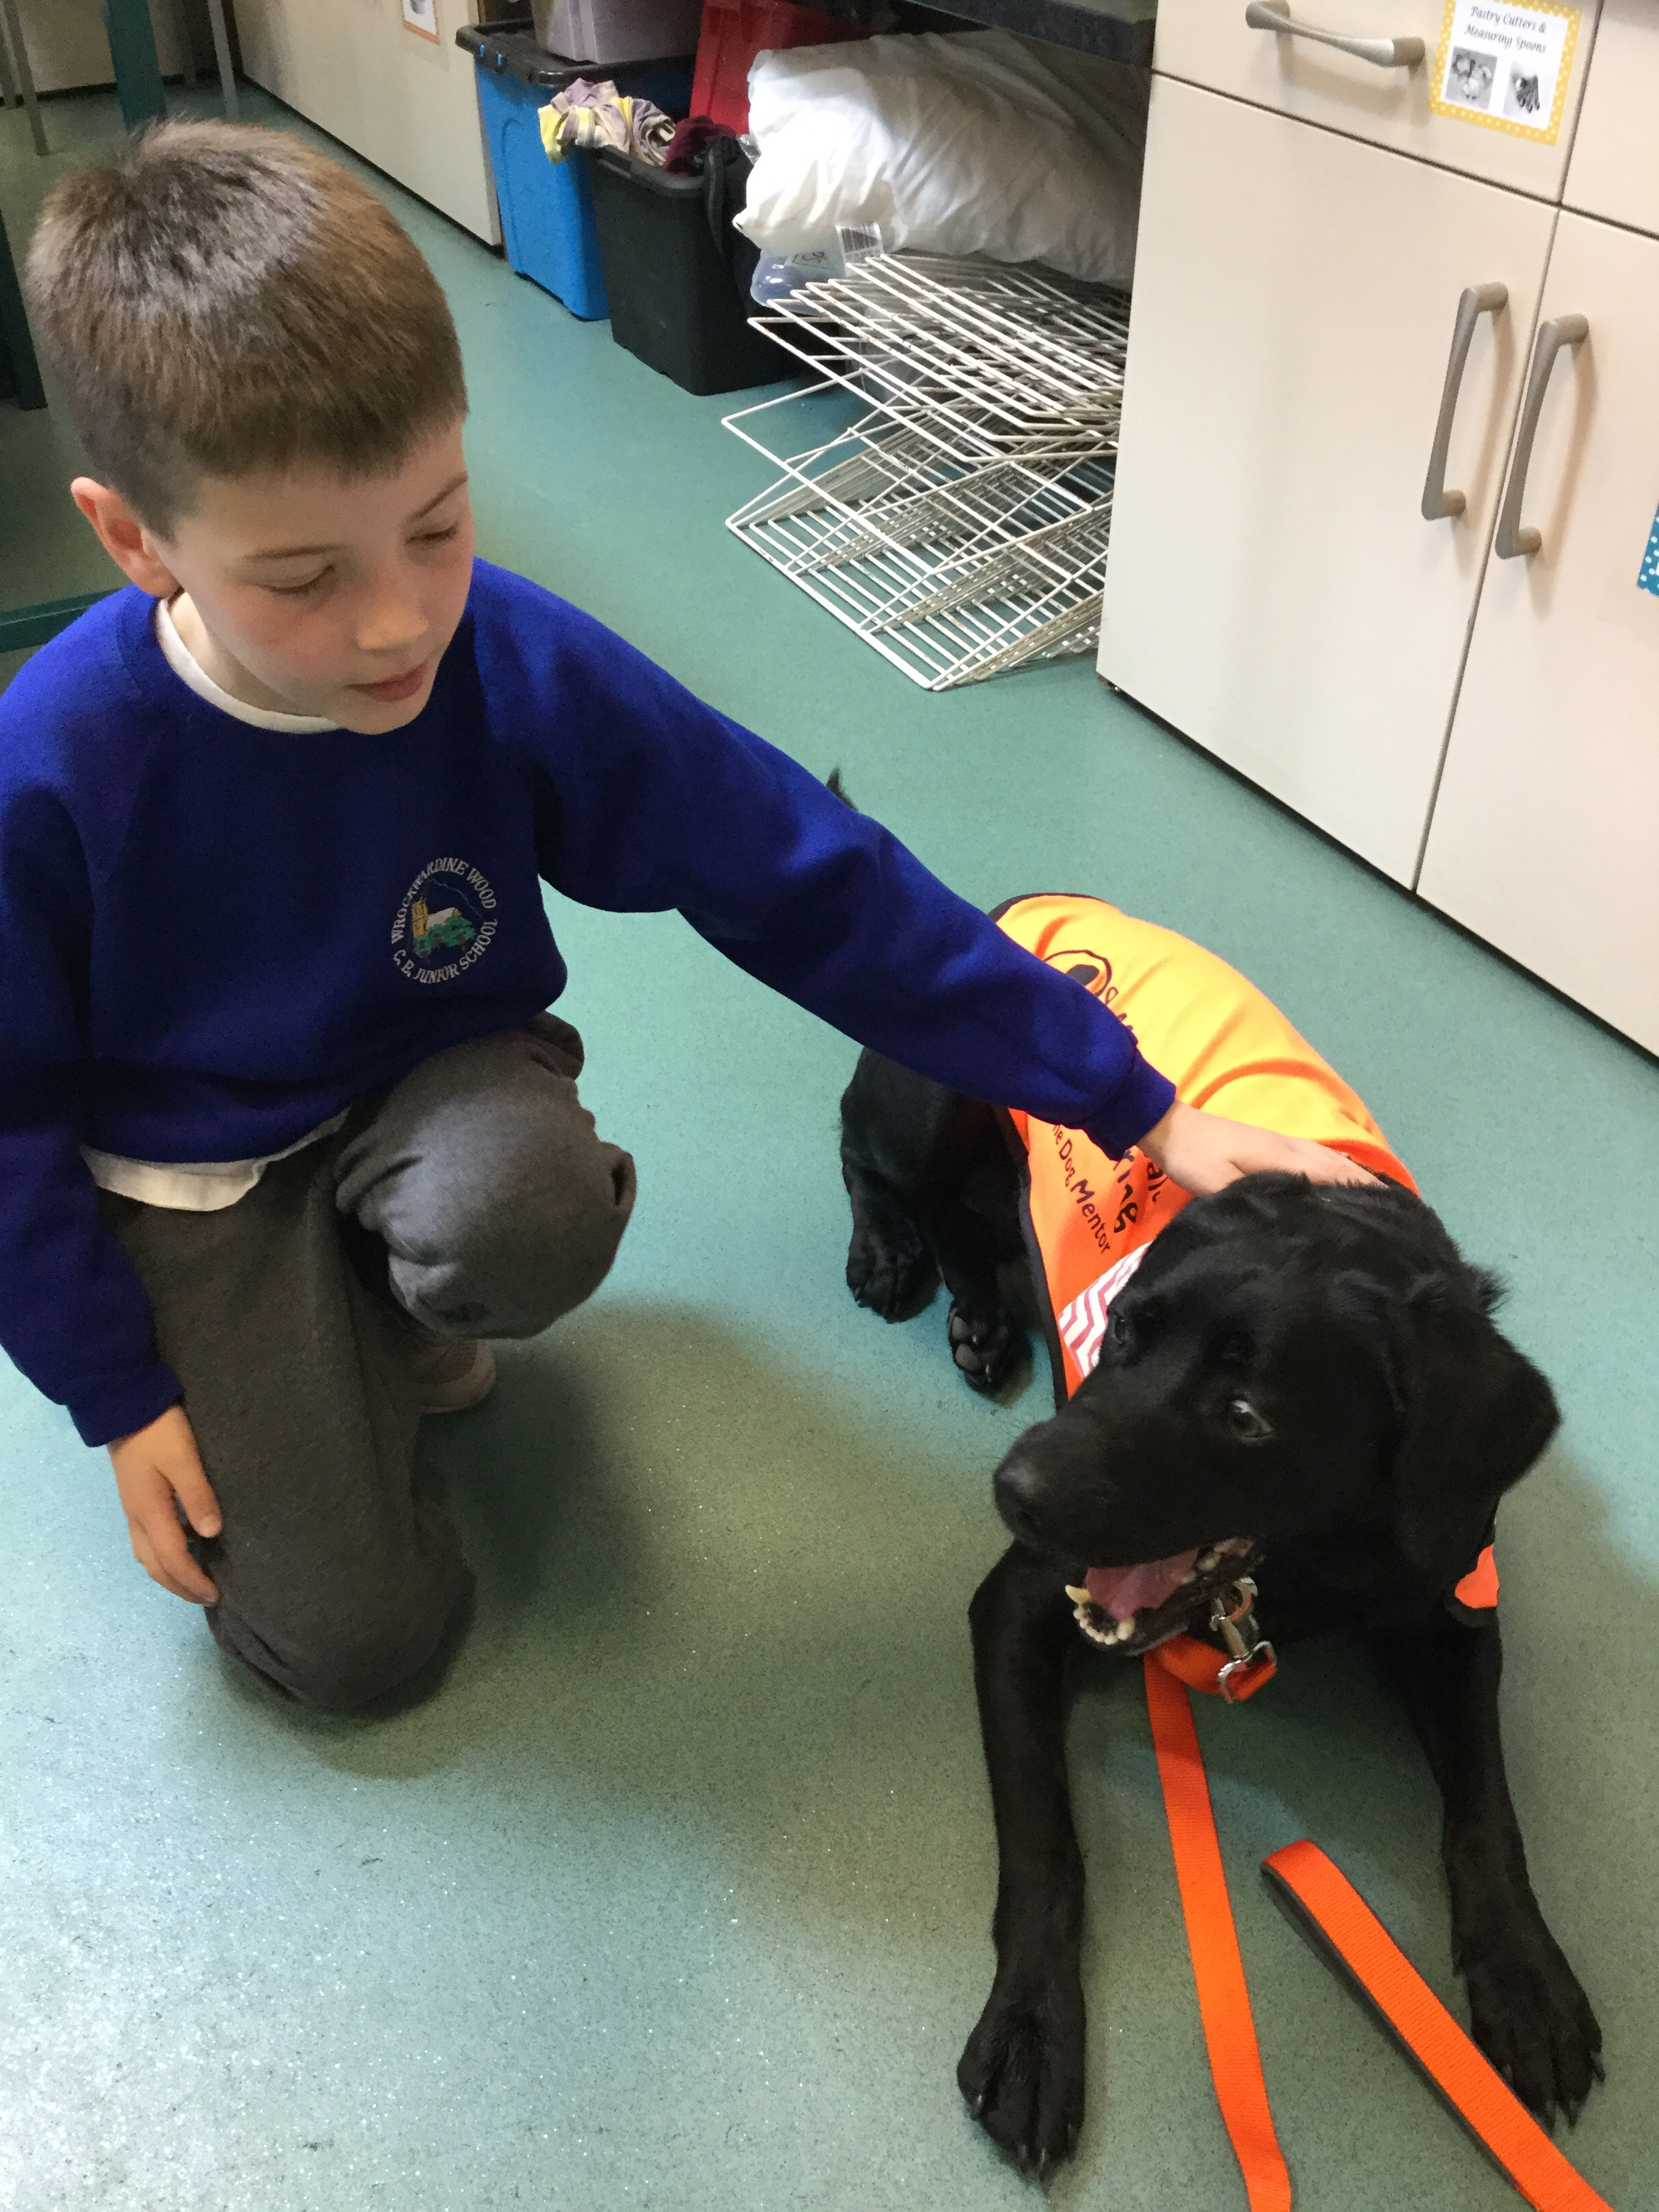
I can’t wait to work with you all I am really looking forward to being a part of your school!

