Slide 1
Lesson 1: What is a spreadsheet?
Save a copy
Year 6 – Data and information – Introduction to spreadsheets
Notes:
This resource is available online at ncce.io/dat6-1-s. Resources are updated regularly — please check that you are using the latest version.
This resource is licensed under the Open Government Licence, version 3. For more information on this licence, see ncce.io/ogl.

Slide 2
Lesson 1: What is a spreadsheet?
Objectives
To identify questions which can be answered using data
I can explain the relevance of data headings
I can answer questions from an existing data set
I can ask simple relevant questions which can be answered using data
Notes:
Primary – objectives slides

Slide 3
What is a spreadsheet?
Introduction
A spreadsheet is a computer application that allows users to organise, analyse, and store data in a table.
Think, write, pair, share: What do you know about spreadsheets?
Notes:
Allow time for learners to think, write, pair, share using their whiteboards and pens.
Be aware that some users will not have any prior knowledge of spreadsheets.
Spreadsheet: https://pixabay.com/vectors/spreadsheet-excel-table-diagram-98491/

Slide 4
What does this data show?
Introduction
 | A | B
1 | Reina | 10
2 | David | 13
3 | Yiannis | 1
4 | Bob | 5
5 | Amin | 9
6 | Petra | 18
Data in spreadsheets is stored in a table. What might this data be showing?
Notes:
Remind the learners that data in spreadsheets is stored in a table.
Tell the learners that this is an example of some data taken from a spreadsheet.
Discuss possible answers from the group such as scores from a game, age, etc.

Slide 5
Data headings
Introduction
 | A | B
1 | Name | Number of days off
2 | Reina | 10
3 | David | 13
4 | Yiannis | 1
5 | Bob | 5
6 | Amin | 9
7 | Petra | 18
Data headings allow us to organise the data in a meaningful way.
Notes:
Tell the learners that the data shows the names of children in a class and the number of days that they have been off school during the year.
Click to play the animation.
Tell the learners that it is important to use data headings in spreadsheets to arrange the data in an organised way so that it can be analysed effectively.

Slide 6
What’s the answer?
Activity 1
Can you answer the questions using the spreadsheet?
Notes:
Question mark: https://pixabay.com/illustrations/question-mark-why-icon-blue-usa-1332062/

Slide 7
Spreadsheet questions
Activity 1
 | A | B | C | D
1 | Fruit | Cost | Number sold | Subtotal
2 | Apples | £0.40 | 4 | £1.60
3 | Bananas | £0.50 | 9 | £4.50
4 | Kiwi | £0.80 | 3 | £2.40
5 | Grapefruit | £1.00 | 1 | £1.00
6 |  |  | Total income: | £9.50

Slide 8
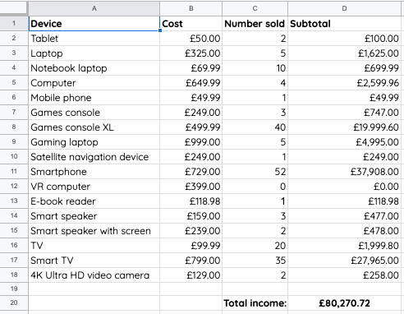
What do you think this spreadsheet is showing?
Activity 2
Notes:
It features the different devices on sale in a small computing shop. Explain that it shows the different devices, the price of each device, the number of devices sold, the subtotal from the sale of each device, and the total income.
Ask the learners some example questions, such as “How much does a laptop cost?” (£325.00). Model how you found this information.

Slide 9
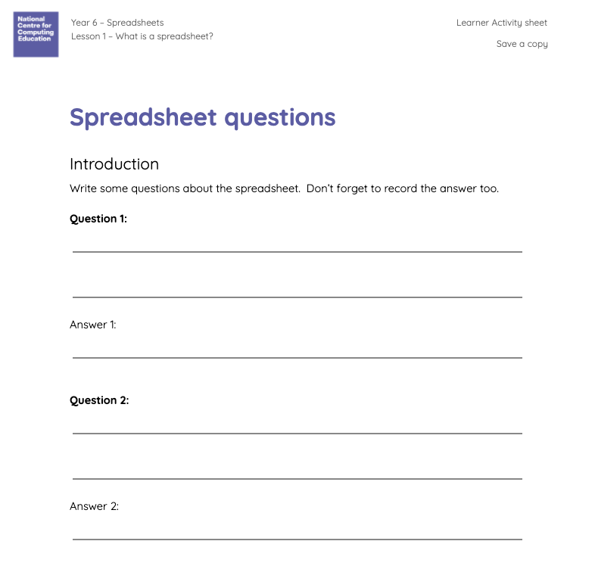
Can you ask simple, relevant questions about the data?
Activity 2
Notes:
Question 1: What are the headings in this spreadsheet?
Answer: Fruit, cost, number purchased, and subtotal
Question 2: What do you think this spreadsheet is showing?
Answer: A shopping list/the cost of fruit purchased
Question 3: How much do apples cost?
Answer: 40 pence
Question 4: What heading appears in cell C1?
Answer: Number purchased
Question 5: Which is the most expensive fruit on the spreadsheet?
Answer: Grapefruit
Question 6: How did the person who made the spreadsheet work out the subtotal in cell D4?
Answer: Multiplied the cost of a kiwi by the number purchased (£0.80 multiplied by 3)

Slide 10
Spreadsheet questions
Activity 2
Can you ask and answer questions about a spreadsheet?
Notes:
Question mark: https://pixabay.com/illustrations/question-mark-why-icon-blue-usa-1332062/

Slide 11
Spreadsheet quiz
Plenary
Ask your questions to the class!
Notes:
Quiz: https://pixabay.com/illustrations/quiz-tiles-letters-red-game-test-2074324/

Slide 12
How confident are you? (1–3)
Assessment
I can explain the relevance of data headings
I can ask simple relevant questions which can be answered using data
I can answer questions from an existing data set
3 - Very confident
2 - Unsure
1 - Not confident
Notes:
Image source: https://pixabay.com/vectors/thumb-up-hand-like-confirm-go-top-307176/

Slide 13
Next lesson
Summary
In this lesson, you…
Identified questions which can be answered using data
Next lesson, you will…
Explain that objects can be described using data

